Slide 1




Implementation of Blockchain System
COMP5521

Slide 2
Agenda
Blockchain Prototype
Network
Mining
Attack
Transaction
Storage
Notes:
Divited to 6 parts

Slide 3
Blockchain Prototype

Slide 4
Blockchain Construction
Index: the height of the current block.
Timestamp.
Previous Block Hash.
Current Block Hash.
Difficulty: the number of 0’s bits at the beginning of block hash.
Nonce: the random number used to calculate the block hash.
Merkle root of transactions.
Data: transactions.
Notes:
We inplement 7 things in our data structure

Slide 5
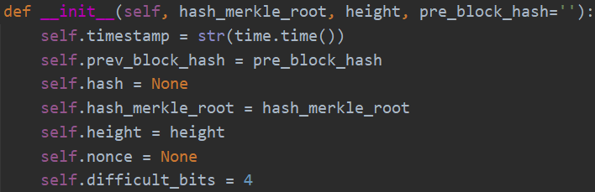
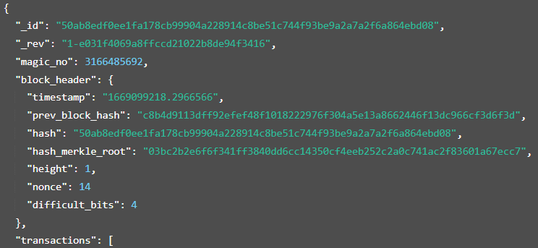
Notes:
Code here of all veriables
Finally we store all the things in the database， as the format we show here

Slide 6
1. Node handshake
2. Get block data
3. Transaction broadcast
Network
Notes:
Here we introduce three requests

Slide 7
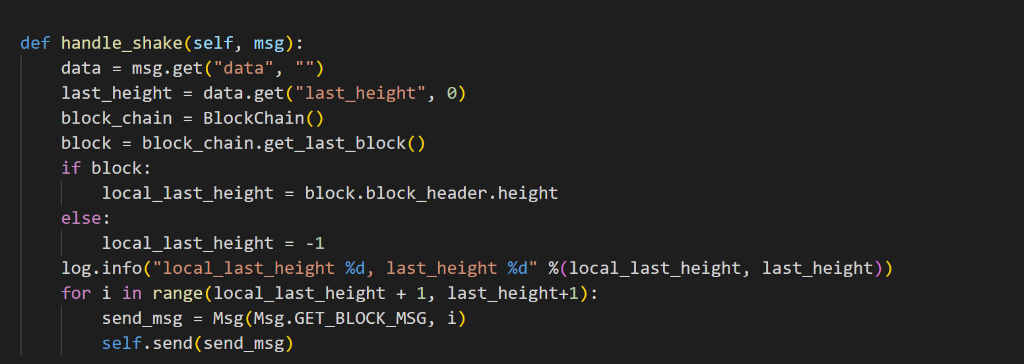
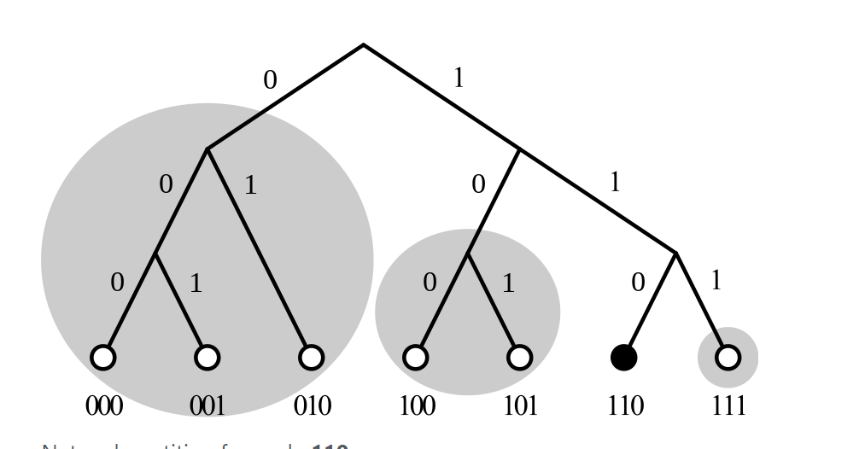
Node handshake
UDP:protocol discovery
TCP:data transmission
Notes:
We use Kademlia. it is a p2p node discovery protocol. Its core is to find nearby nodes by calculating the logical distance between nodes to achieve the convergence of node search. Here we used the package provided by python, So I won't go farther on that.
In terms of network protocols, we learn from the practice of Ethereum, UDP is used for protocol discovery, and TCP is used for data transmission. Whenever a node is found, a connection is established via TCP
The latest block height and genesis block are sent out for comparison with local data. If the remote data is updated, then a new part of the block is obtained.

Slide 8
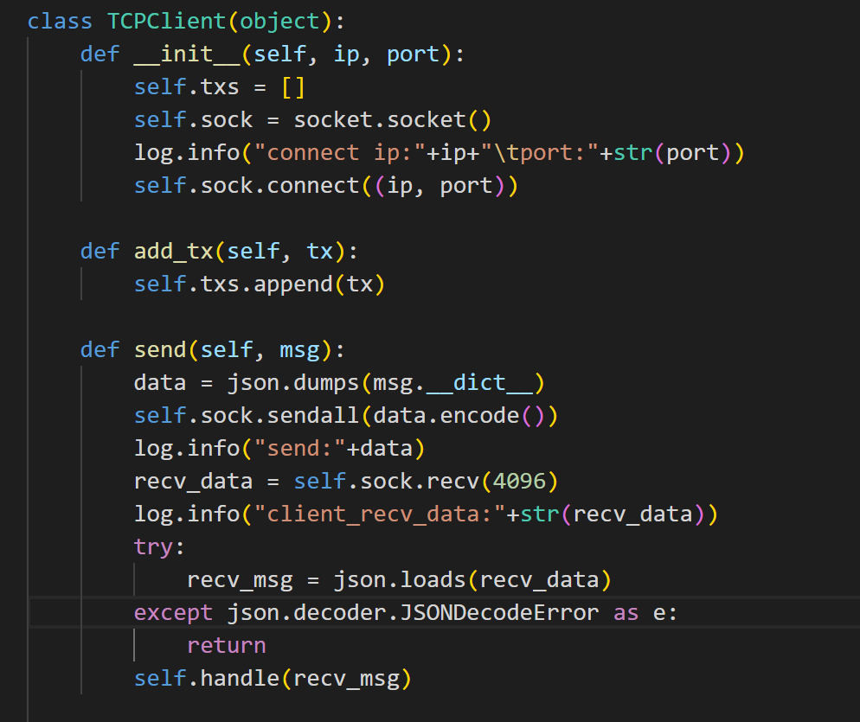
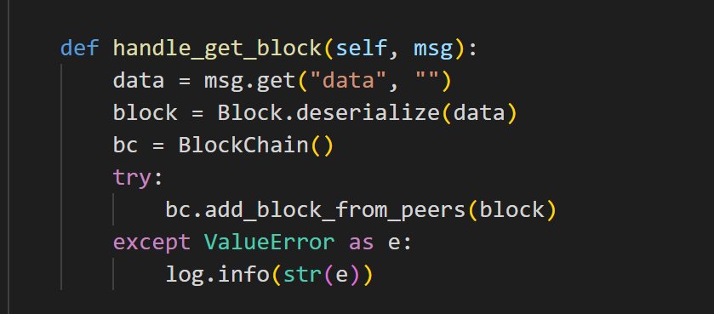
get block
node1
database
node2
deserialization
txs
TCP
ADD
update
Notes:
After deserialization, the information of the block in the database is sent to other blocks through transmission

Slide 9
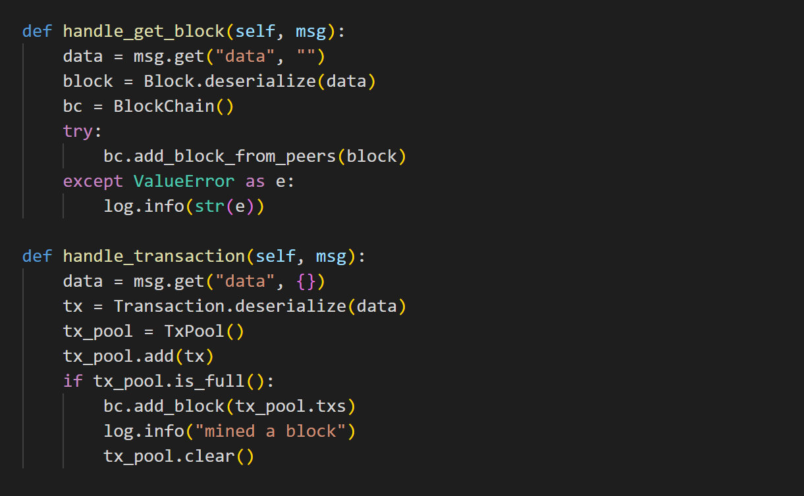
Transaction broadcast
Handle transaction
transaction pool
2. Get block
From server /update
3. Handle shake
Lower height
4. Shake loop
10s
Notes:
1.Process the transaction sent by the server, add the transaction to the transaction pool, and add it to the blockchain if the transaction pool is full
2.Process the block sent by the server and update the block to the chain.
3.Process the handshake information responded by the server, and if it is found that the current block height is lower than the block height responded in the data, then initiate a request to obtain several new blocks.
4.A handshake message is sent every 10 seconds (blocks are synchronized every 5 seconds), and if there is a transaction that needs to be broadcasted, the transaction will be broadcasted.

Slide 10
Mining
Notes:
Hello everyone, now it's my turn to explain our project to you.
In my round, I will explain the consensus of the system and simulate the network attack of the blockchain

Slide 11
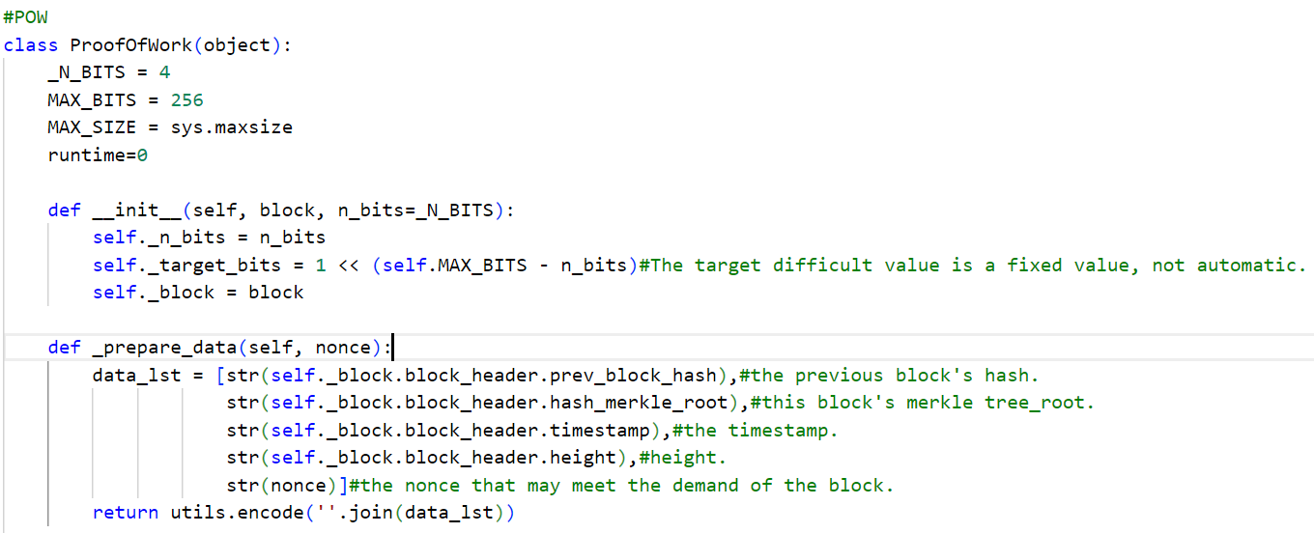
Proof of Work
init: Before mining for the first time, we need to set the initial difficulty
Hash the msg: the message includes
Notes:
This blockchain uses the pow consensus.
In the project, before the node calls the pow.
Firstly, the data needs to be set as an initial value if the node doesn’t mine a block before.
N_BITS: A value we use to adjust the mining difficulty
Target_bits: This is a measure. The hash value that the miner calculates should be less than this value, so that the block can be mined and verified
-------
And before mining, we also need to merge the data of the previous block and prepare for hashing.

Slide 12
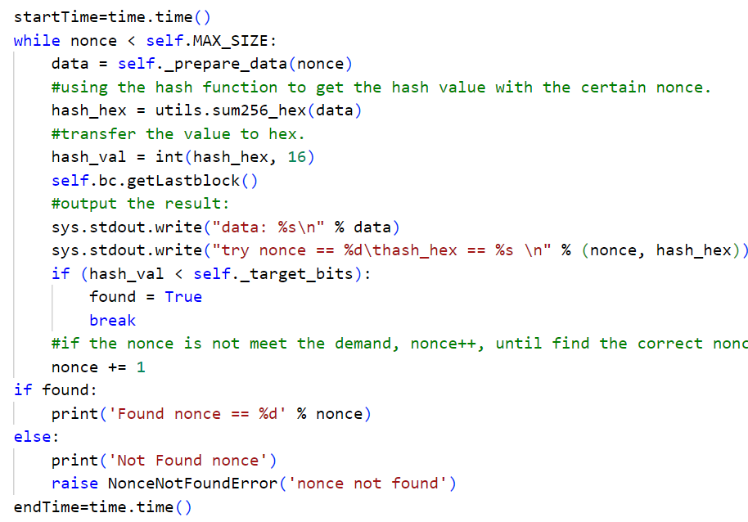
Proof of Work
We use the pre_data and nonce to get the hash value(SHA-256)
Convert value to hex and compare with target_bits
⬅Get the mining time
Notes:
Then we begin to mine the block
The node will use the nonce value to keep trying to calculate the hash value until it calculates a result that meets the requirements.
If the nonce meets the demand, making the hash value is less than the target bits.
This nonce succeed.
And we also get the mining time

Slide 13
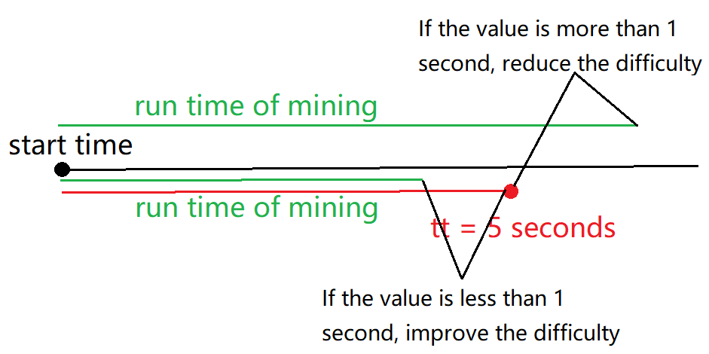
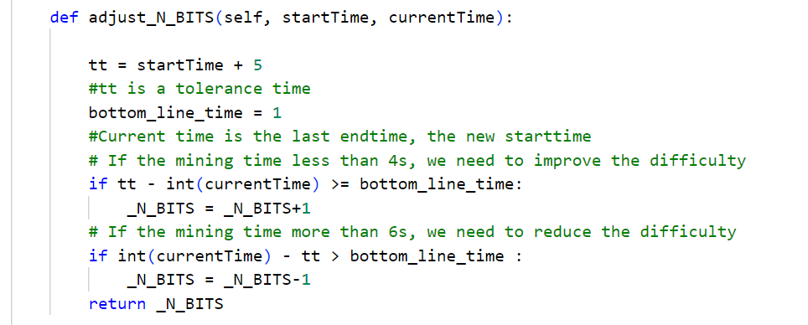
Implementation of dynamic difficulty
For instance, god hoped that his questions could be answered in about 5 seconds by his people(not less or more than 1 second)
If not, god will change the difficulty of the Q.
Notes:
Next I will introduce how to implement the dynamic difficulty.
Here I give an example.
If the mining time is less than 4s, it means that the calculation is too fast and the difficulty should increase.
If the mining time is greater than 5s, it means that the calculation is too slow, so reduce the difficulty.

Slide 14
Attack
Notes:
Next is the attack part.

Slide 15



51% Attack
A 51% attack is a precondition for a double spending attack, which means that if the computing power of a certain node’s miner is greater than half of the total computing power in the blockchain, then the node will give priority to verifying new blocks
PC01:Limit computing power
PC02:No limited. Initial balance：2200
PC03:Limit computing power
PC04:Limit computing power
Notes:
In order to prove the 51% attack, we set up four computers, the second computer does not limit the computing power,
and the other computers add the sleep function to the pow algorithm to simulate that their computing power is limited
-----------------------------
If all the blocks are mined by PC02, we can prove that the 51% attack is achieved.

Slide 16
Transaction

Slide 17
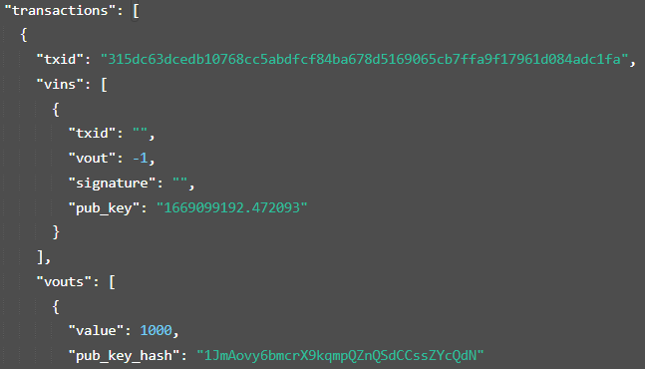
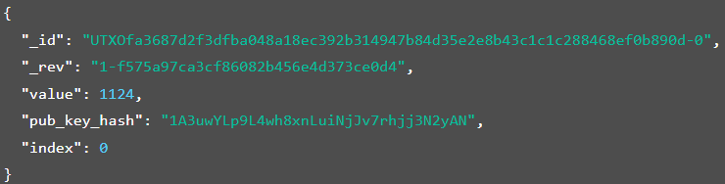
Implementation of P2PKH
Structure: a transaction ID + multiple transaction inputs + multiple transaction outputs
Coinbase Transaction
Unspent Transaction Output
Notes:
Instead of p2pk, we use p2pkh to implement the transaction part. In this way the address can reweal less information and previde more safety.
Coinbase tx are used to receive rewards from blocks generation
UTXO are used to located the unspent txs to save indexing time

Slide 18
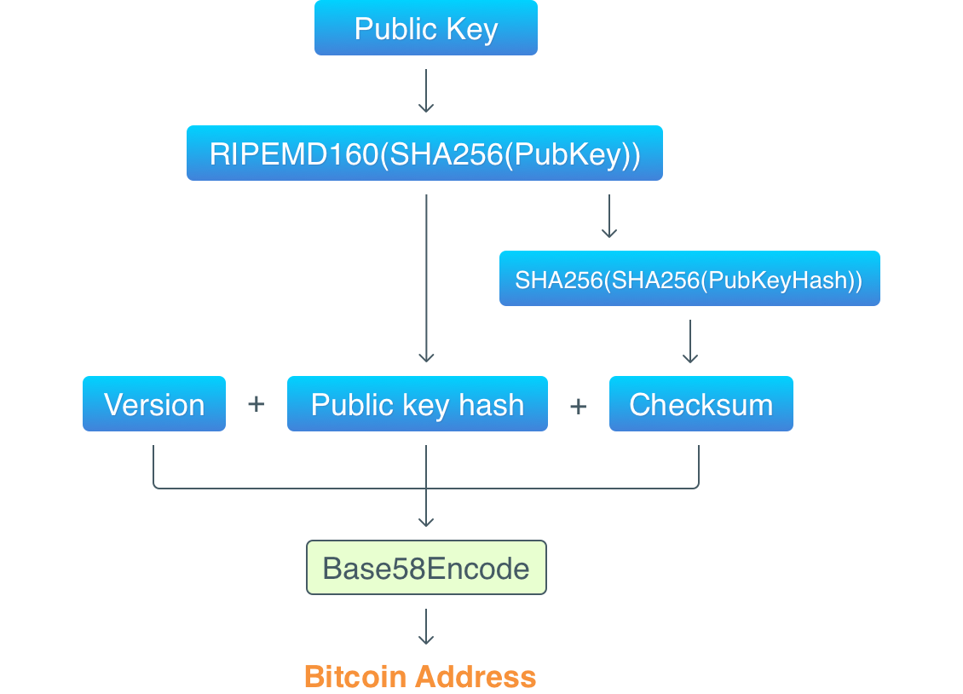
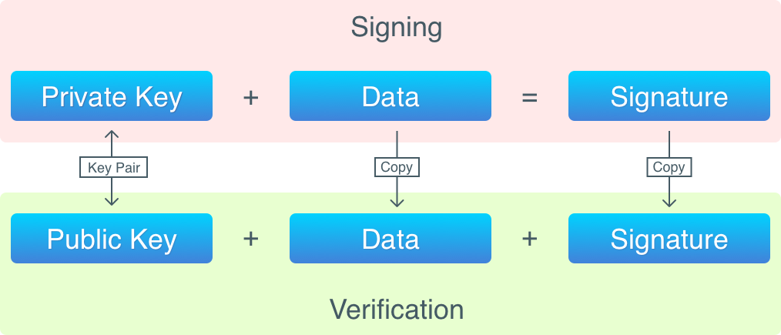
Key pair and Address
Elliptic Curve Digital Signature Algorithm (ECDSA)
Curve-SECP256k1
Notes:
Key pair generation based on algorithm names ECDSA with curve—
Private key used to singing and public key used to verification
Address is generated by public key with several steps 2 hashes and one based 58 encode

Slide 19
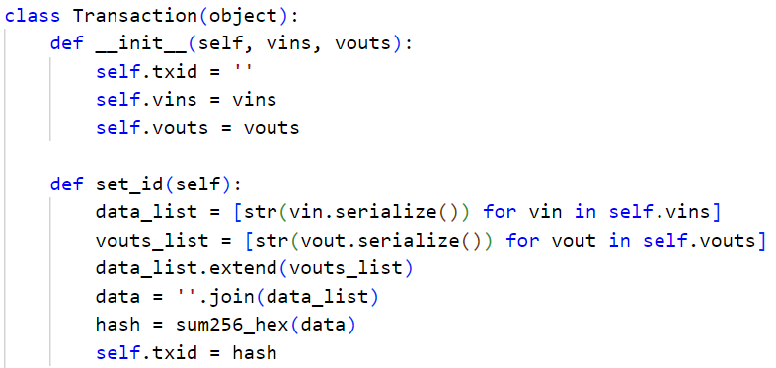
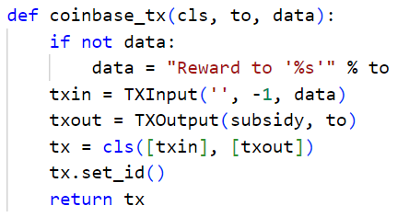
Transactions
Merge the input and outputs into string and then hash them to generate Txid
Notes:
Extend the inputs and outputs into string, and hash them to generate a txid.

Slide 20
Digital signatures and verification
Transaction raised
Find all UTXOs and check amounts whether are enough or not, input will redeem coins from UTXOs
Sign and unlock inputs with the private key in the wallet
Others can verify its signature with the public key hash
Send the transaction to the pool and wait for a new block proposed
Transaction done

Slide 21
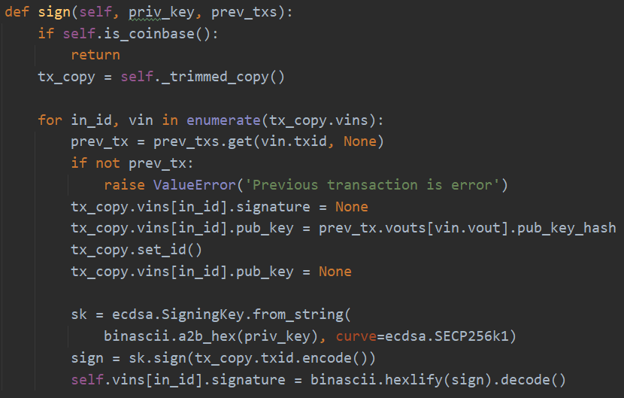
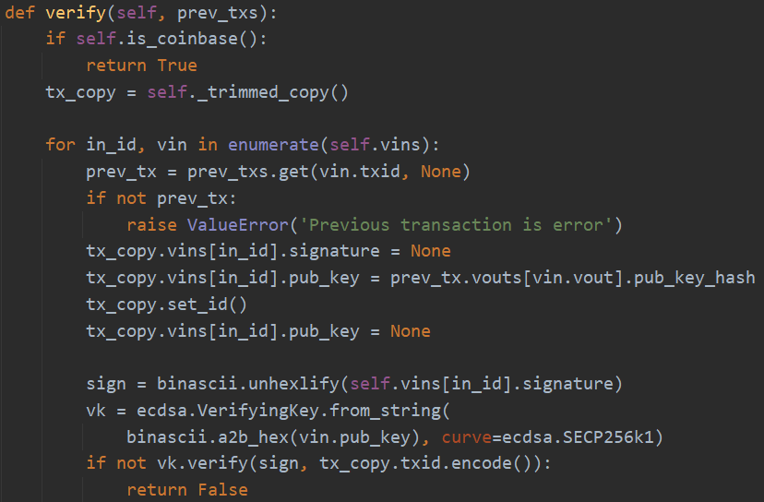
Notes:
We sign the txid with private key, and in verification part, we verify the signature with public key.

Slide 22
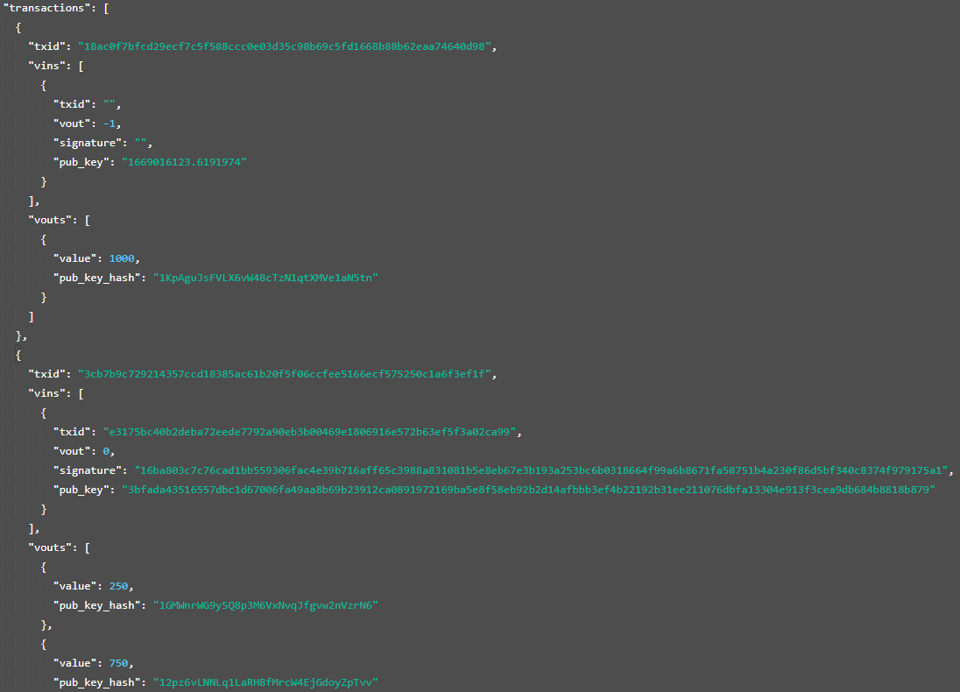
Transactions stored in Blocks
Notes:
This is the details of transactions shown in the blocks.

Slide 23
Storage

Slide 24
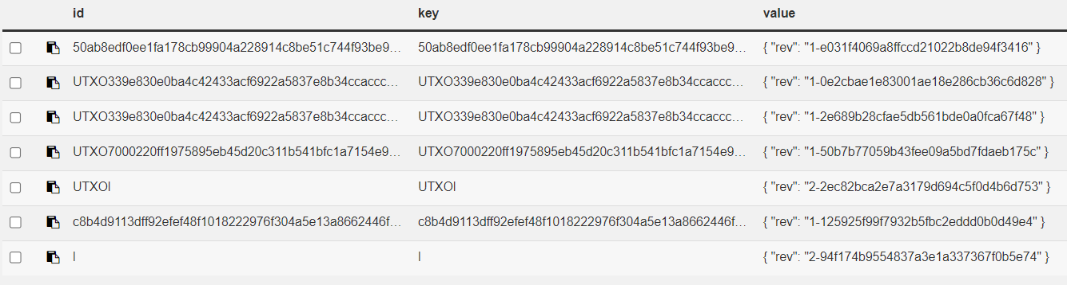
Database-CouchDB
The whole blockchain store in local disk
http://127.0.0.1:5984/
b) UTXO in database with a UTXO flag
Notes:
Although they are shown in the same db for convenience, the blockchain actually doesn’t contain the UTXOs, they are totally two constructions. Only the containers without UTXO and are in irregular id are the blocks in blockchain. UTXO are stored in local.

Slide 25
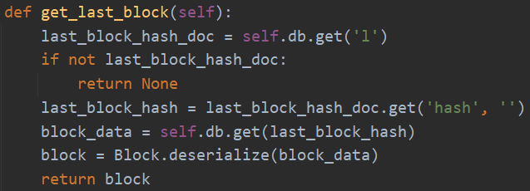
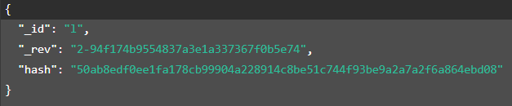
c) Get the latest state from database to local memory
Notes:
For indexing conveniency

Slide 26
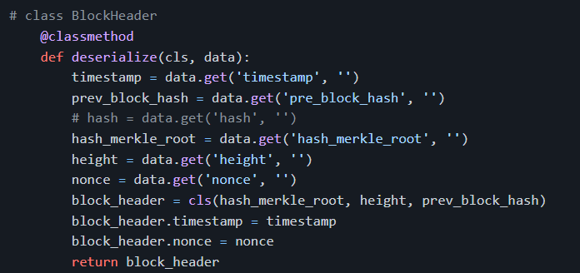
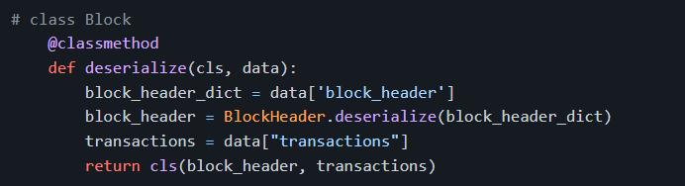
CouchDB

Slide 27
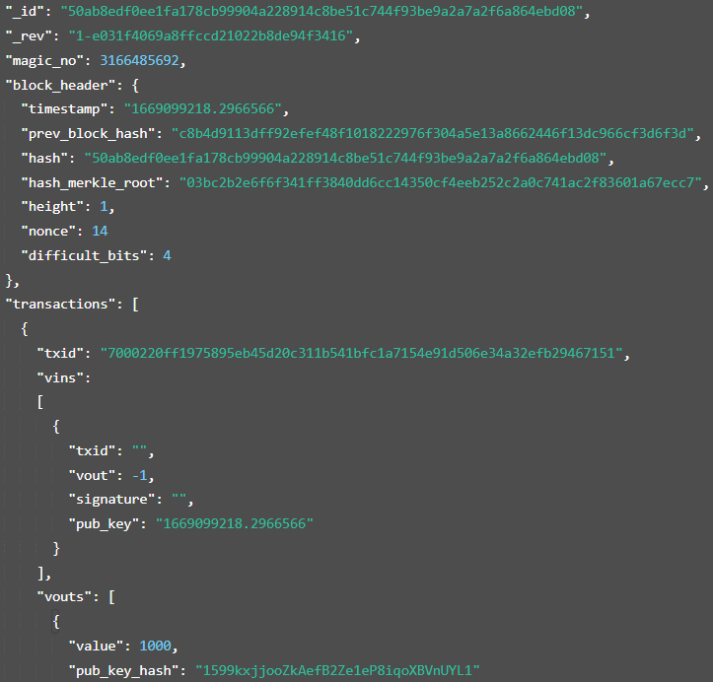

Slide 28
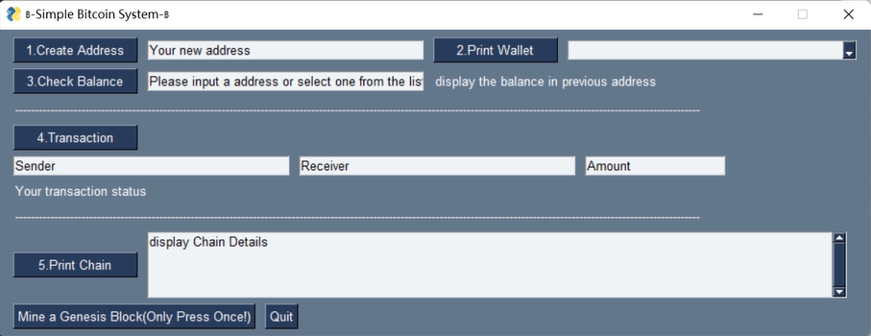
User Interface

Slide 29
Thank you

